Slide 1
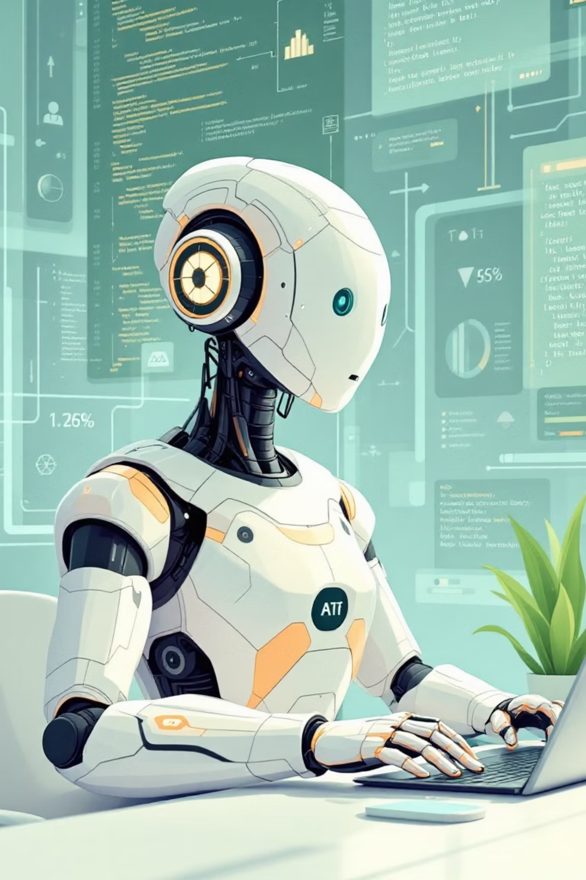
The Rise of Agentic AI:Building Proactive, Autonomous Systems
Presenter: Ravi
Sep 19, 2025

Slide 2
Today's Journey
01
02
03
Agentic AI overview
AI Evolution
Reactive vs. Proactive
Rise of Agentic AI
Traditional to agentic AI
Paradigm shift explained
04
05
06
LLMs as Foundation
RAG Systems
Agent Architecture
Brain of agentic systems
Bridging knowledge gaps
Core AI agent components
07
08
09
CrewAI Framework
CrewAI Components
Live Demo Setup
Multi-agent orchestration
Agents, tasks, and crews
Preparation walkthrough
10
11
12
Live Demo
Engineering Impact
Key Takeaways
Automated email workflow
For software engineers
Core concepts synthesis
13
14
Future of Software
Q&A Discussion
Transformative potential ahead
Questions and closing thoughts

Slide 3

Why Agentic AI Changes Everything
The AI Revolution is Here – Are You Ready to Lead It?
The landscape of technology is evolving at an unprecedented pace. AI is no longer a distant future; it's here, reshaping industries and creating new possibilities. Reports indicate 80% of enterprises are planning significant AI adoption by 2025, with the global AI market projected to hit $1.8 trillion by 2030. Early adopters are already seeing productivity gains of up to 30%.
However, traditional AI systems, while powerful, often fall short. They are reactive, confined to specific tasks, and demand constant human supervision. This creates a bottleneck, limiting true autonomy and hindering their ability to tackle complex, multi-step problems without explicit, continuous direction.
What Makes Agentic AI Different?
Proactive Decision-Making
Autonomous Problem Solving
Agents initiate actions and make decisions based on high-level goals, not just immediate prompts, driving towards objectives autonomously.
They can break down complex tasks, self-correct errors, and adapt their strategies dynamically to new information and changing environments.
Orchestrated Workflows
Reduced Human Overhead
Multiple agents can coordinate and collaborate intelligently, forming sophisticated workflows to achieve overarching business objectives efficiently.
By handling repetitive or complex operational tasks, agentic AI frees software engineers to focus on higher-level strategy, innovation, and creative problem-solving.
As software engineers, you are at the forefront of this transformative wave. Understanding and harnessing Agentic AI is not just about keeping pace; it's about equipping yourselves to design, build, and deploy the next generation of intelligent systems that will define the future of technology.

Slide 4

The Evolution of Artificial Intelligence
Traditional AI
Machine Learning
Rule-based, reactive systems
Predictive, data-driven models
Examples: calculators, spam filters
Examples: recommendation engines
Large Language Models
Agentic AI
Language understanding and reasoning
Goal-driven, proactive, autonomous
Examples: ChatGPT, Gemini
Examples: AI assistants booking flights end-to-end
📈 From simple inputs & outputs → autonomous workflows

Slide 5


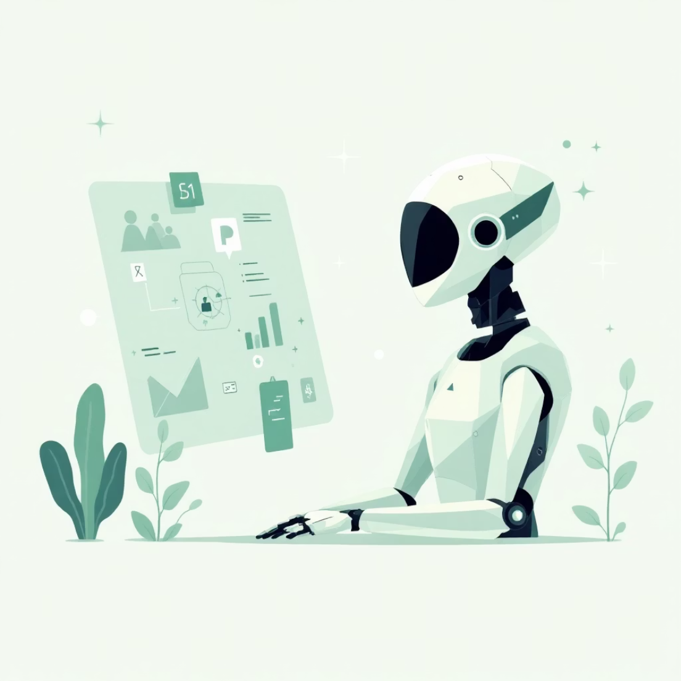

From Reactive to Proactive Systems
Traditional AI
Large Language Models
Agentic AI
One input → One output
Understand & generate human-like text
Plans, acts, adapts to goals
Example: "Translate text" → returns translation
Example: "Summarise this report" → coherent summary
Example: "Schedule a meeting" → finds slots, checks calendars, sends invites
🧠 The Paradigm Shift
AI transforms from passive responder to autonomous problem-solver

Slide 6

LLMs: The Foundation Layer
LLMs are the Brain
They reason, plan, and generate human-like language with remarkable sophistication
But LLMs Alone Aren't Agents
Memory: Forget after each query
Tools: Can't act without APIs
Autonomy: Only respond, never initiate
How LLMs Function
Learn patterns from massive training datasets
Generate responses using internal parameters
Limited by static training knowledge
🔑 Agentic AI = LLM + Memory + Tools + Autonomy

Slide 7
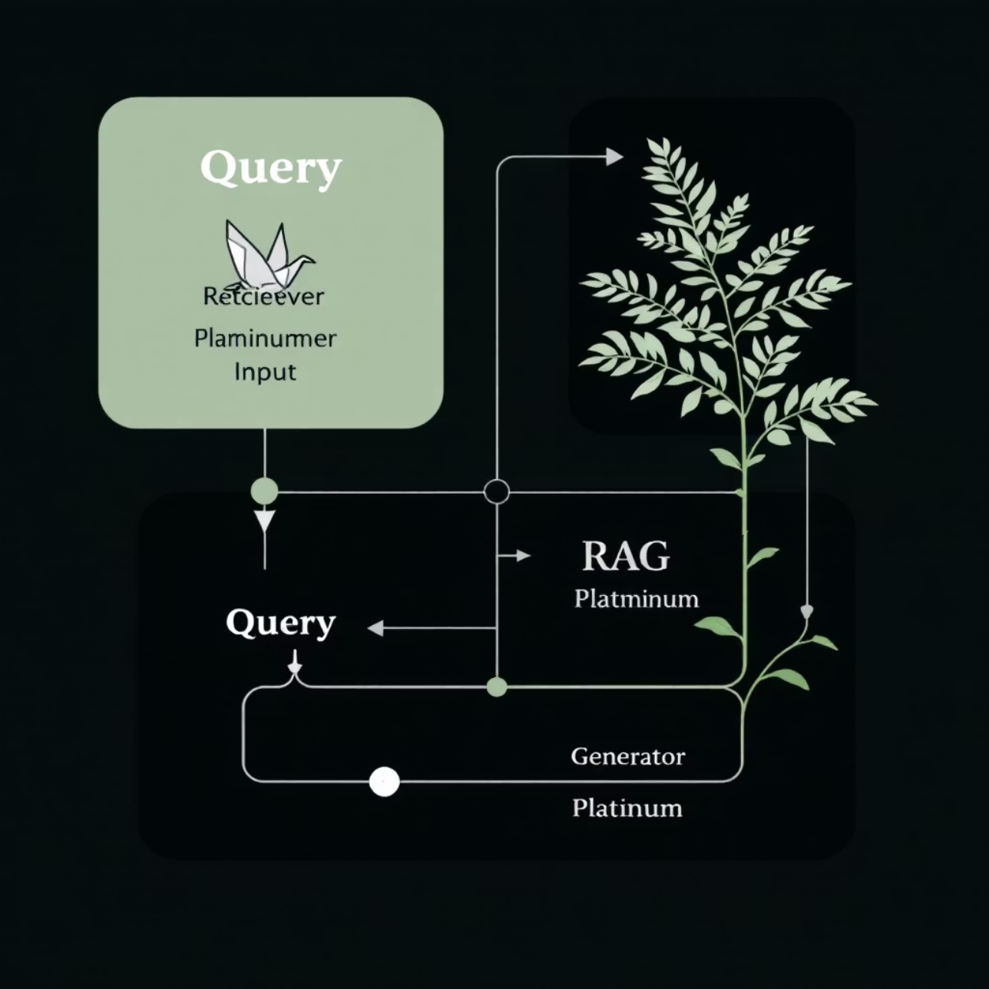
RAG: Bridging Static and Dynamic Knowledge
Retrieval-Augmented Generation
Extends LLMs with External Knowledge
Runtime Context Retrieval
Connects to vector databases, search engines, and live documentation
Retriever pulls relevant information → LLM uses it for enhanced responses
Dynamic Information Access
Bridges gap between static training data and real-time information needs

Slide 8









The Anatomy of an AI Agent
Agentic AI goes beyond answering → it plans, reasons, and executes
LLM (Brain)
Memory System
Plans strategies and reasons through complex problems
Short-term: task context
Long-term: knowledge/history
Orchestration (Heart)
Tools (Hands)
Decides next actions, delegates tasks, coordinates workflows
APIs, databases, email, search engines, code execution environments
📌 Think: "A personal assistant with memory, tools, and initiative"

Slide 9




CrewAI: Orchestrating AI Teams
Multi-Agent Collaboration Framework
CrewAI is a Python framework designed for coordinating multiple AI agents working together
Agent
Specialised worker (researcher, writer, coder) with defined roles and capabilities
Task
Assigned work units (research trends, draft emails, generate reports)
Crew
Manager that coordinates agents, assigns tasks, and ensures completion
⚙️ Transforms LLMs into a "team of specialists"

Slide 10
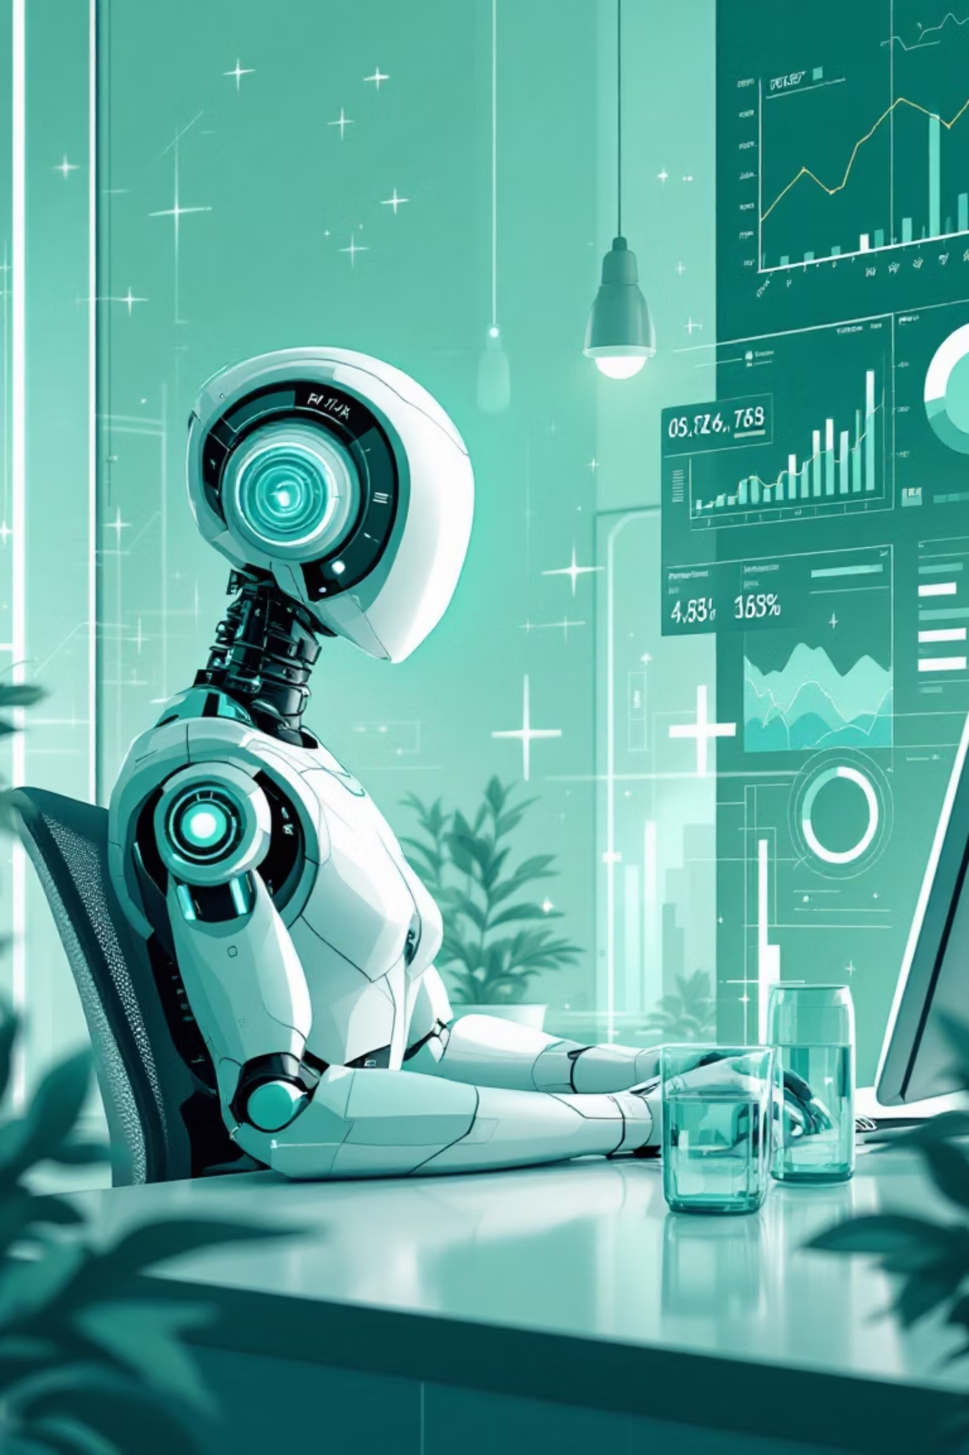
CrewAI Components in Action
Example: Market Research Agent Implementation
Agent Configuration
1
Role: Research Analyst - Market Trends Expert
Goal: "Find latest AI adoption statistics and industry insights"
Tools: GoogleSearch API, WebScraper, DataProcessor
Task Definition
2
Description: "Summarise top 3 AI trends from 2024 Q4 with supporting data"
Expected Output: Structured Markdown report with citations and sources
Context: Focus on enterprise adoption patterns
Crew Orchestration
3
Coordination: Brings together tasks and agents seamlessly
Execution: Runs workflows in sequence or parallel as needed
Quality Control: Validates outputs and ensures task completion

Slide 11




Live Demo: Automated Email Workflow
Witness Agentic AI in action with a practical scenario:
Script Walkthrough
Agent Collaboration
Real-time Outcome
We'll examine the CrewAI script, defining agents, roles, tools, and the overall workflow.
See how tasks are delegated, agents interact, and progress towards the defined goal.
Observe the human approval step and the automatic email dispatch triggered by the AI crew.

Slide 12

Why This Matters for Engineers
Agentic AI is fundamentally reshaping the software development landscape, elevating the role of engineers and unlocking unprecedented opportunities for innovation.
From API Wiring to System Design
Building Proactive Applications
Engineers transition from connecting APIs to architecting intricate, autonomous systems capable of proactive decision-making.
Develop intelligent solutions that automate complex, multi-step processes, self-manage, and adapt dynamically to achieve goals.
Unlocking Cross-Industry Scalability
Harmonising Human & AI
Apply agentic principles to create impactful applications across diverse sectors such as finance, healthcare, marketing, and DevOps.
Design sophisticated systems that seamlessly integrate human expertise with advanced AI capabilities, fostering a new era of collaborative intelligence.

Slide 13





Key Takeaways
Recap of our journey into the world of Agentic AI:
Agentic AI: The New Paradigm
LLMs Powering Autonomy
AI systems are evolving from reactive tools to autonomous, proactive problem-solvers that plan, reason, and execute.
Large Language Models are the 'brain', but agents add critical components like memory, tools, and orchestration for true initiative.
RAG for Dynamic Knowledge
CrewAI: Orchestrating AI Teams
Retrieval-Augmented Generation bridges the knowledge gap, providing LLMs with real-time, external information beyond their training data.
Frameworks like CrewAI enable the coordination of multiple specialised AI agents to work collaboratively on complex tasks.

Slide 14



Future of Software
Agentic AI is set to fundamentally redefine software development and application capabilities:
Engineers as Orchestrators
Adaptive, Proactive Applications
Seamless Human-AI Collaboration
The focus shifts from manual coding to designing and managing sophisticated multi-agent systems, where engineers become architects of AI collaboration.
Software will no longer just respond to commands but will proactively anticipate needs, plan solutions, and execute tasks autonomously, learning and adapting continuously.
Future applications will blend human creativity and intuition with AI's efficiency, augmenting our abilities and streamlining complex workflows across all industries.
🚀 This paradigm shift empowers us to build more intelligent, resilient, and human-centric software.

Slide 15

Questions?
Thank you for your time!

